Slide 1


Android Dice Rolling: A Java Project
Create a dice rolling app in Java for Android. Learn about random number generation and its significance in gaming development.

Slide 2

Introduction
1
Purpose of the Project
Develop a mobile app that simulates rolling dice, providing an interactive experience for users.
2
Importance of Random Number Generation in Gaming
Learn how random numbers are crucial in games, ensuring fairness and unpredictability.

Slide 3

Development Environment Setup
1
Required Software and Tools
Install Android Studio, Java Development Kit (JDK), and necessary SDK components for Android app development.
2
Configuration and Installation Steps
Configure Android Studio, set up an emulator, and create a new project for dice rolling.

Slide 4

Creating the User Interface
Designing the Dice Layout
Implementing the Roll Button Functionality
Create a visually appealing layout with two dice images and a roll button. Utilize XML layout files for customization.
Add event listeners and define actions for the roll button to generate random dice values upon click.

Slide 5
Coding the Dice Rolling Logic
Defining the Random Number Generation Algorithm
Assigning Random Values to Dice Faces
Explore different algorithms, such as the Java Random class, to generate random numbers for each dice roll.
Map randomly generated numbers to specific dice face images, creating the illusion of rolling dice.

Slide 6

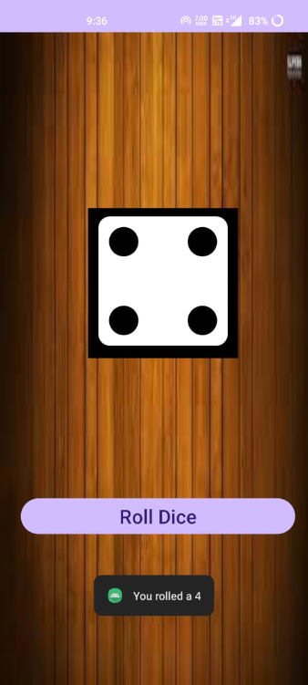
GAME OF DICE

Slide 7

Testing and Debugging
1
Verified the Functionality of the Dice Roll
Thoroughly tested the app to ensure accurate and random results for each roll.

Slide 8

Conclusion
1
Future Enhancements and Possibilities
Potential improvements, such as adding, rolling animation to dice, sound effects, multiplayer functionality.

